Slide 1
Chapter 4
Time Value of Money 1: Analyzing Single Cash Flows
Finance 6th Edition
Cornett, Adair, and Nofsinger
© McGraw Hill LLC. All rights reserved. No reproduction or distribution without the prior written consent of McGraw Hill LLC.

Slide 2
Learning Goals
Create a cash flow time line.
Compute the future value of money.
Show how the power of compound interest increases wealth.
Calculate the present value of a payment made in the future.
Move cash flows from one year to another.
Apply the Rule of 72.
Compute the rate of return realized on selling an investment.
Calculate the number of years needed to grow an investment.

Slide 3
Introduction 1
Time value of money (T V M)
Refers to the difference in buying power for a dollar over time.
Used in both business and personal life.
Factors to consider when making T V M decisions:
Size of the cash flows.
Time between the cash flows.
Rate of return we can earn.

Slide 4
Introduction 2
Basic idea behind the time value of money is that $1 today is worth more than $1 promised next year
How much more?
Depends on current interest rates.

Slide 5
Organizing Cash Flows
Managing cash flow timing is one of the most important tasks in successfully operating a business
A time line is a graphical representation showing the size and timing of cash flows through time (for example, monthly, quarterly, semiannually, or yearly).
Cash received is called an inflow and is denoted with a positive number.
Cash that leaves is an outflow and is designated with a negative number.

Slide 6
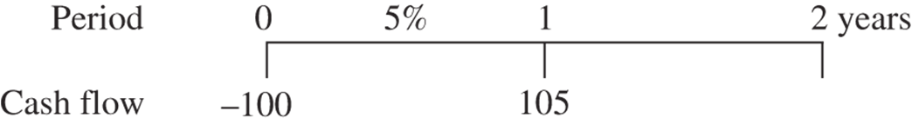
Time Line Example
Suppose you deposit $100 at a bank and allow the bank to rent your $100 for a year at a cost (that is, interest rate) of 5 percent, or $5.
Given the 5 percent interest rate, having $100 now (in year 0) has the same value as having $105 in one year.
Access the text alternative for slide images.

Slide 7
Future Value
Future value (F V) is the value of an investment after one or more periods
For example, the $105 one-time cash flow that your bank credits to your account in one year is the future value of $100 in one year at a 5 percent annual interest rate.

Slide 8
Single-Period Future Value 1
To compute the future value of a sum of money one year from today, you simply add the interest earned to today’s cash flow.
In equations, interest rates appear in decimal format:

Slide 9
Single-Period Future Value 2
Note this this is the same as
In the second equation, we need the 1 in the parentheses to recapture the original deposit and the 0.05 for the interest earned.

Slide 10
Single-Period Future Value (Concluded)
Present value (P V) is the amount a future cash flow is worth today.
We compute the future value one year from now,

Slide 11
Compounding and Future Value
Compounding is the process of adding interest earned every period on both the original investment and the reinvested earnings.
Simple interest is interest earned only on the original deposit.

Slide 12
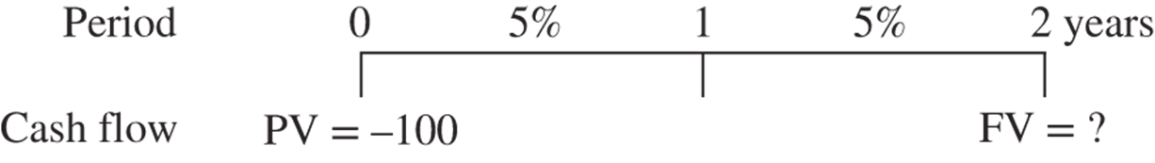
Compounding Example 1
Let’s illustrate a $100 deposit made for two years at 5 percent in the following time line:
We could solve for the two-year compounded F V by using the 1-year equation twice:
Access the text alternative for slide images.

Slide 13
Compounding Example 2
We could also solve for the two-year compounded F V more directly (and much faster) using the following approach:
We could solve for the two-year compounded F V by using the 1-year equation twice:

Slide 14
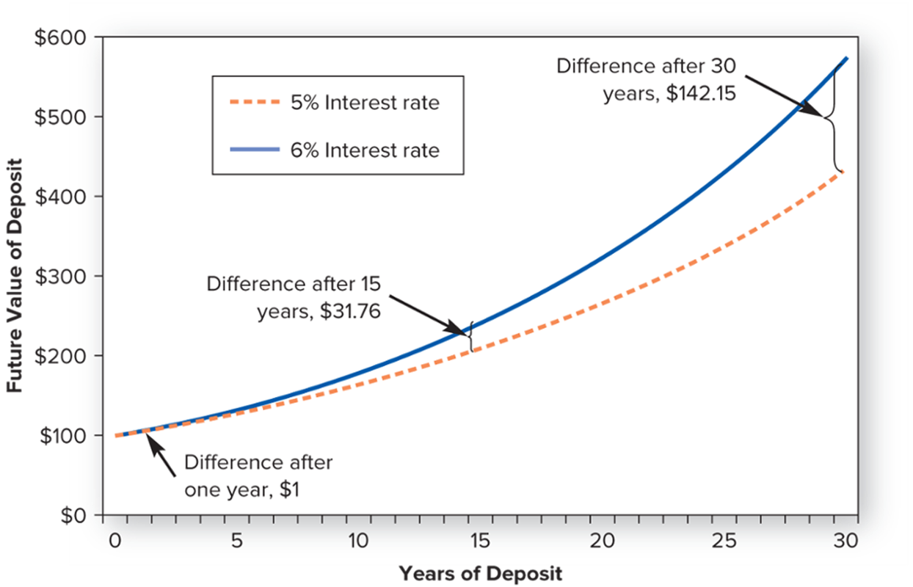
The Future Value of $100
Access the text alternative for slide images.

Slide 15
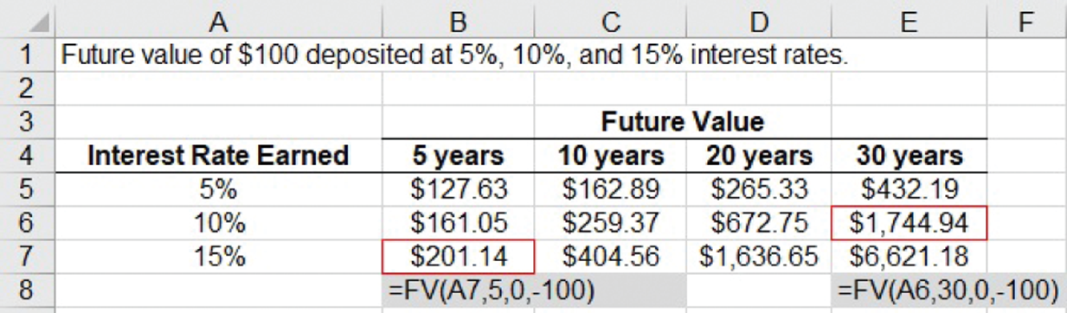
The Power of Compounding
Earning higher interest rates on the investment (or earning the same interest rate for additional time periods) magnifies compounding power.
Access the text alternative for slide images.

Slide 16
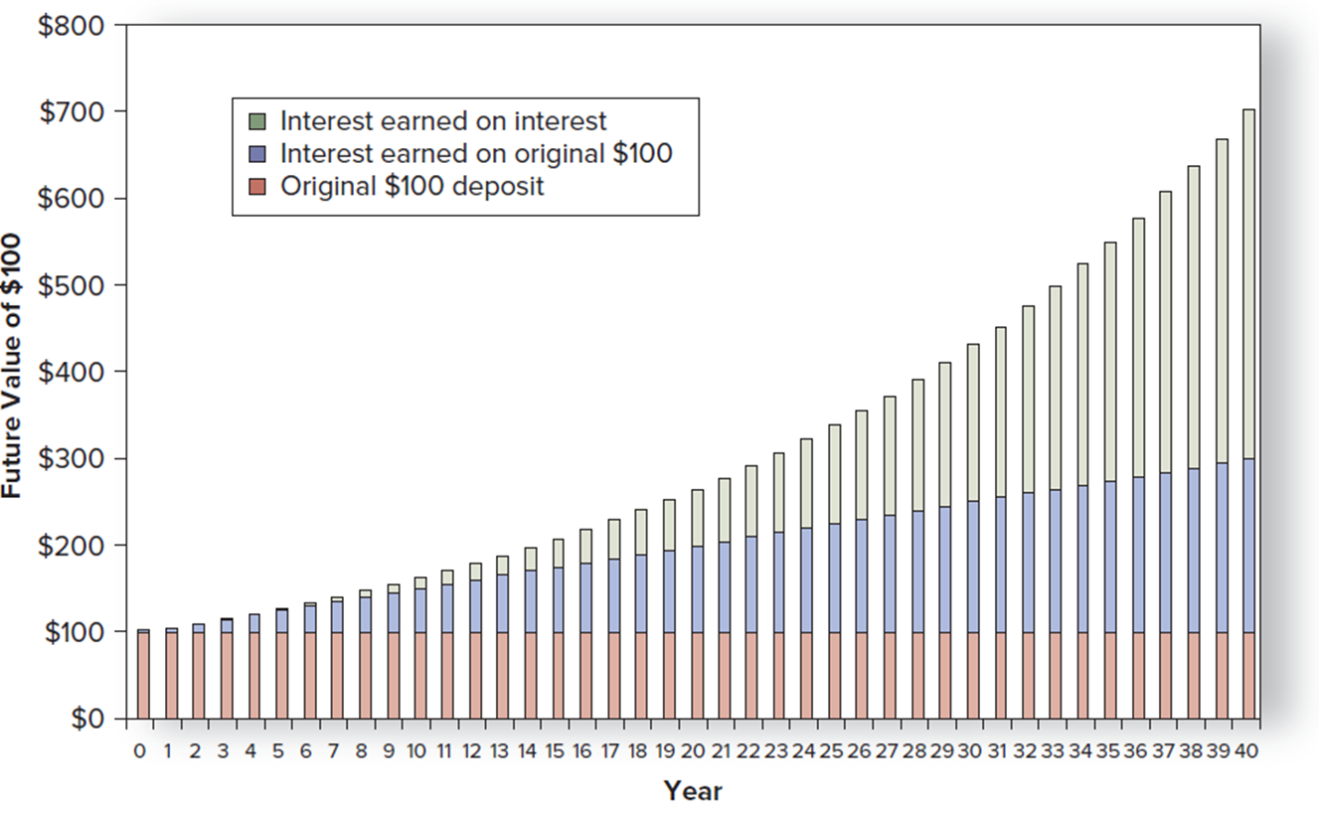
Interest Earned on Prior Interest at a 5 Percent Rate
Access the text alternative for slide images.

Slide 17
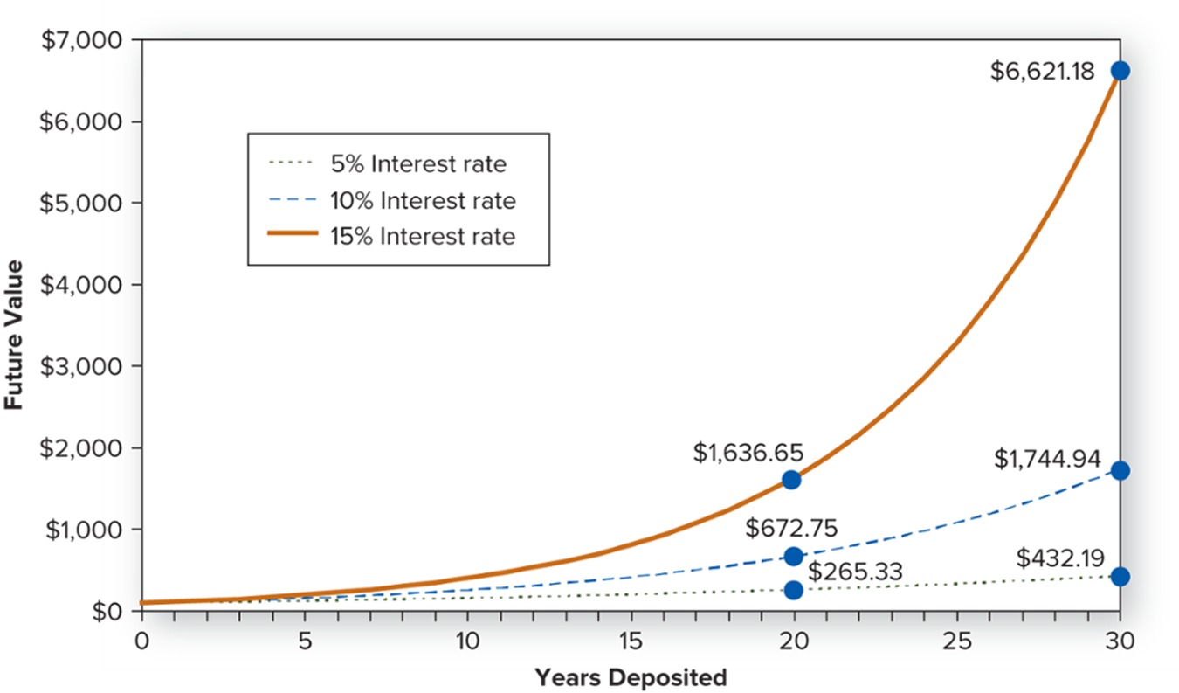
Impact of Time and Magnitude of Interest Rate
Access the text alternative for slide images.

Slide 18
Present Value
Finding the present value is essentially the opposite process as finding the future value
Future value = compounding.
Example: What happens when you deposit $100 cash in the bank to earn 5 percent interest for one year?
Present value = discounting.
Example: If the bank will pay you $105 in one year and interest rates are 5 percent, how much would you be willing to deposit now to receive that payment in a year?

Slide 19
Discounting
Discounting is the process of finding present value by reducing future values using the discount, or interest, rate
Significantly decreases the value of a future amount to the present.

Slide 20
Present Value Example
Suppose the bank is going to pay $105 in one year and interest rates are 5 percent.
What is the present value?
Present values are always smaller than future values (if interest rates are positive).

Slide 21
Discounting Over Multiple Periods
Discounting over multiple periods is simply the reverse of compounding over multiple periods.

Slide 22
Discounting Over Multiple Periods Example
If you receive a $100 cash flow in five years, what is its present value, discounted at 5 percent?
Discount rate is the interest rate used to discount future cash flow(s) to the present.
INPUT | 5 | 5 |  | 0 | 100
 | N | I/YR | PV | PMT | FV
OUTPUT |  |  | −78.35

Slide 23
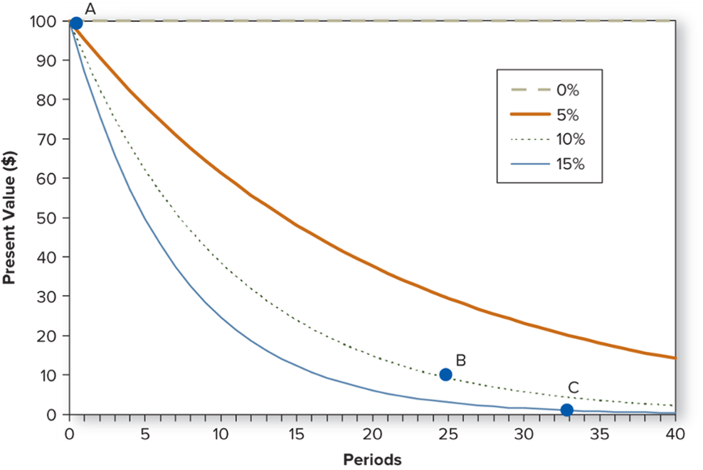
Evaluating Different Discount Rates
Higher interest rates discount future cash flows more quickly and dramatically.
Access the text alternative for slide images.

Slide 24
Discounting with Multiple Rates
A future cash flow can be discounted at different interest rates per period.

Slide 25
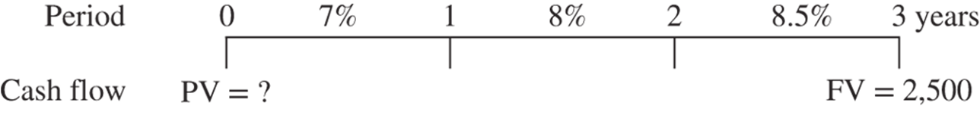
Discounting with Multiple Rates Example
Suppose we expect interest rates to increase over the next few years, from 7% this year, to 8% next year, to 8.5% in the third year
What is the present value of a future $2,500 cash flow in year 3?
Access the text alternative for slide images.

Slide 26
Using Present Values and Future Values
Managers may find it useful to move cash flows to different points in time as they analyze investment projects, debt management, and cash flows
Use P V equation to move cash flows to an earlier point in time.
Use F V calculation to move cash flows to a later point in time.

Slide 27
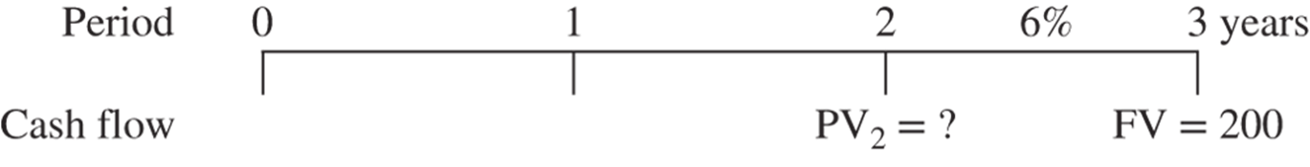
Moving Cash Flows Example 1
What’s the value in year 2 of a $200 cash flow to be received in three years, when interest rates are 6 percent?
Move $200 payment in the third year to a value in the second year, requiring the P V equation.
Access the text alternative for slide images.

Slide 28
Moving Cash Flows Example 2
What about moving the $200 cash flow to year 5?
Requires moving the cash flow later in time by two years, so we use the future value equation.
INPUT | 2 | 6 | −200 | 0
 | N | I/YR | PV | PMT | FV
OUTPUT |  |  |  |  | 224.72

Slide 29
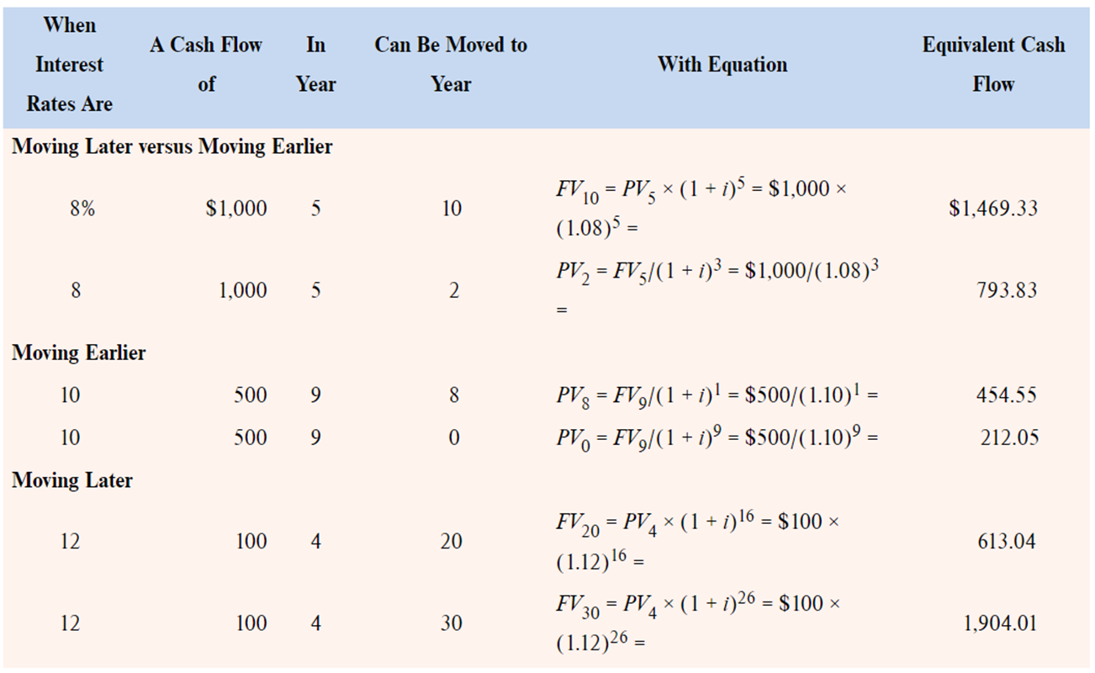
Equivalent Cash Flows in Time
Access the text alternative for slide images.

Slide 30
Rule of 72
Albert Einstein introduced a simple mathematical approximation for the number of years required to double an investment, called the Rule of 72.

Slide 31
Rule of 72 Example
How many years will it take to double money deposited at 6 percent per year?
Rule of 72 calculation.
Rule of 72 can also be used to approximate the interest rate needed to double an investment in a specific amount of time.

Slide 32
Computing Interest Rates 1
Solving for the interest rate, or rate of return, can answer questions like the following:
If you bought a gold coin for $350 three years ago and sell it now for $475, what rate of return have you earned?
Notes:
Note that computing interest rates is easiest with a financial calculator.

Slide 33
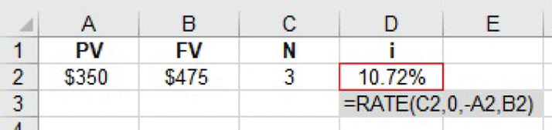
Computing Interest Rates 2
Calculator solution:
INPUT | 3 |  | −350 | 0 | 475
 | N | I/YR | PV | PMT | FV
OUTPUT |  | 10.72
Excel solution:
Access the text alternative for slide images.
Notes:
Note that computing interest rates is easiest with a financial calculator.

Slide 34
Solving for Time
It may be useful to determine the time period needed to accumulate a specific amount of money
Information needed to solve for the number of years that you will need to accumulate that money.
Starting cash flow.
Interest rate.
Future cash flow (or, the amount you will need).
Complex calculation – use financial calculator!

Slide 35
Solving for Time Example
When interest rates are 9%, how long will it take $5,000 to double?
Calculator inputs:
I = 9%.
P V = −5,000.
P M T = 0.
F V = 10,000.
Solution: 8.04 years

Slide 36
End of Main Content
© McGraw Hill LLC. All rights reserved. No reproduction or distribution without the prior written consent of McGraw Hill LLC.

Slide 37
Accessibility Content: Text Alternatives for Images

Slide 38
Time Line Example – Text Alternative
Return to parent-slide containing images.
Periods are indicated from 0 to 2 years in increments of 1. Cash flow is indicated below the periods as follows: 0, negative 100. 1, 105. Interest rate is indicated as 5 percent between the period 0 and 1.
Return to parent-slide containing images.

Slide 39
Compounding Example 1 – Text Alternative
Return to parent-slide containing images.
Periods are indicated from 0 to 2 years in increments of 1. Cash flow is indicated below the periods as follows: 0, P V equals negative 100. 2, F V equals question mark. Interest rate is indicated as 5 percent between the periods 0 and 1, and 1 and 2 years.
Return to parent-slide containing images.

Slide 40
The Future Value of $100 – Text Alternative
Return to parent-slide containing images.
The horizontal axis represents years of deposit ranging from 0 to 30 in increments of 5. The vertical axis represents future value of deposit ranging from 0 to 600 dollars in increments of 100 dollars. A solid line represents future value of 100 dollars at 6 percent interest rate and a dotted line represents the future value at 5 percent interest rate. Both the lines start from 100 dollars. Both the lines increase constantly along the horizontal axis with the solid line moving above the dotted line. The difference between the two lines after one year is indicated as 1 dollar. The difference after 15 years is 31.76 dollars and that after 30 years is 142.15 dollars.
Return to parent-slide containing images.

Slide 41
The Power of Compounding – Text Alternative
Return to parent-slide containing images.
Interest rate earned is indicated in column A. Future values in 5 years, 10 years, 20 years, and 30 years are shown in columns B, C, D, and E, respectively. The row entries are as follows: Row 5: 5 percent, 127.63 dollars, 162.89 dollars, 265.33 dollars, and 432.19 dollars. Row 6: 10 percent, 161.05 dollars, 259.37 dollars, 672.75 dollars, and 1,744.94 dollars. Row 7: 15 percent, 201.14 dollars, 404.56 dollars, 1,636.65 dollars, and 6,621.18 dollars. The formula of cell B 7 reads as equals F V open parenthesis A 7 comma 5 comma 0 comma negative 100 close parenthesis. The formula of cell E 6 reads as equals F V open parenthesis A 6 comma 30 comma 0 comma negative 100 close parenthesis.
Return to parent-slide containing images.

Slide 42
Interest Earned on Prior Interest at a 5 Percent Rate – Text Alternative
Return to parent-slide containing images.
The horizontal axis represents years from 0 to 40 in increments of a year. The vertical axis represents future value of 100 dollars from 0 to 800 dollars in increments of 100 dollars. The bars for each of the years are subdivided as original 100 dollar deposit, interest earned on original 100 dollars, and interest earned on interest from bottom to top. The original 100 dollar deposit diminishes marginally in value as years progress. The interest earned on original 100 dollars increases constantly as years progress. The interest earned on interest is nominal up to 10 years and increases substantially as years progress.
Return to parent-slide containing images.

Slide 43
Impact of Time and Magnitude of Interest Rate – Text Alternative
Return to parent-slide containing images.
The horizontal axis represents years deposited ranging from 0 to 30 years in increments of 5 years. The vertical axis represents future value ranging from 0 to 7,000 dollars in increments of 1,000 dollars. Three lines show the future values at 5 percent, 10 percent, and 15 percent interest rates. The lines increase along the horizontal axis with lines representing higher rates moving above the lines representing lower rates. The future values at 20 years are as follows: 5 percent, 265.33 dollars. 10 percent, 672.75 dollars. 15 percent, 1,636.65 dollars. The future values at 30 years are as follows: 5 percent, 432.19 dollars. 10 percent, 1,744.94 dollars. 15 percent, 6,621.18 dollars.
Return to parent-slide containing images.

Slide 44
Evaluating Different Discount Rates – Text Alternative
Return to parent-slide containing images.
The horizontal axis represents periods ranging from 0 to 40 in increments of 5. The vertical axis represents present value in dollars ranging from 0 to 100 in increments of 10 dollars. Four lines represent discount rates of 0 percent, 5 percent, 10 percent, and 15 percent. All lines start from the top of the horizontal axis. The line representing 0 percent is flat and horizontal along the horizontal axis. The other lines decrease along the horizontal axis with lines representing higher discount rates moving lower than the lines representing lower discount rates. Point A is plotted at 100 dollars on the vertical axis. Point B is plotted on the line representing 10 percent between 10 and 20 dollars at 25 of the horizontal axis. Point C is plotted on the line representing 15 percent at 1 dollar and 33 of the horizontal axis. All data are approximate.
Return to parent-slide containing images.

Slide 45
Discounting with Multiple Rates Example – Text Alternative
Return to parent-slide containing images.
Periods are indicated from 0 to 3 years in increments of 1. Cash flow is indicated below the periods as follows: 0, P V equals question mark. 3, F V equals 2,500. Interest rates are indicated as 7 percent between the periods 0 and 1, 8 percent between periods 1 and 2, and 8.5 percent between 2 and 3 years.
Return to parent-slide containing images.

Slide 46
Moving Cash Flows Example 1 – Text Alternative
Return to parent-slide containing images.
Periods are indicated from 0 to 3 years in increments of 1. Cash flow is indicated below the periods as follows: 2, P V 2 equals question mark. 3, F V equals 200. Interest rate is indicated as 6 percent between 2 and 3 years.
Return to parent-slide containing images.

Slide 47
Equivalent Cash Flows in Time – Text Alternative
Return to parent-slide containing images.
When interest rates are, a cash flow of, in year, can be moved to year, with equation, and equivalent cash flow are the column heads of the table. Under the panel, Moving later versus moving earlier, the row entries are as follows: Row 1: 8 percent, 1,000 dollars, 5, 10, F V 10 equals P V 5 times 1 plus i the whole power 5 equals 1,000 dollars times 1.08 power 5 equals, and 1,469.33 dollars. Row 2: 8 percent, 1,000 dollars, 5, 2, P V 2 equals F V 5 over 1 plus i the whole cube equals 1,000 dollars over 1.08 cube equals, and 793.83 dollars. Under the panel, Moving earlier, the row entries are as follows: Row 3: 10 percent, 500 dollars, 9, 8, P V 8 equals F V 9 over 1 plus i the whole power 1 equals 500 dollars over 1.10 power 1 equals, and 454.55 dollars. Row 4: 10 percent, 500 dollars, 9, 0, P V 0 equals F V 9 over 1 plus i the whole power 9 equals 500 dollars over 1.10 power 9 equals, and 212.05 dollars. Under the panel, Moving later, the row entries are as follows: Row 5: 12 percent, 100 dollars, 4, 20, F V 20 equals P V 4 times 1 plus i the whole power 16 equals 100 dollars times 1.12 power 16 equals, and 613.04 dollars. Row 6: 12 percent, 100 dollars, 4, 30, F V 30 equals P V 4 times 1 plus i the whole power 26 equals 100 dollars times 1.12 power 26 equals, and 1,904.01 dollars.
Return to parent-slide containing images.

Slide 48
Computing Interest Rates 2 – Text Alternative
Return to parent-slide containing images.
P V is indicated as 350 dollars in A 2, F V as 475 dollars in B 2, N as 3 in C 2, and i as 10.72 percent in D 2. The formula for cell D 2 is shown as equals RATE open parenthesis C 2 comma 0 comma minus A 2 comma B 2 close parenthesis.
Return to parent-slide containing images.

